Slide 1
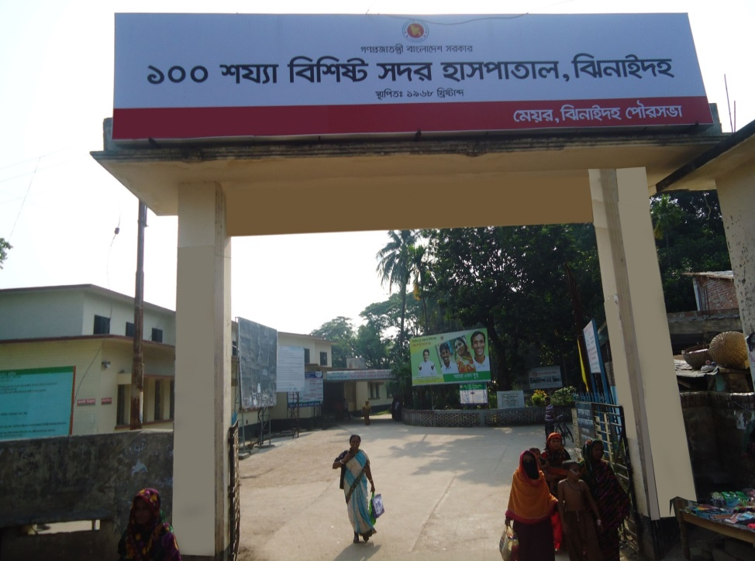
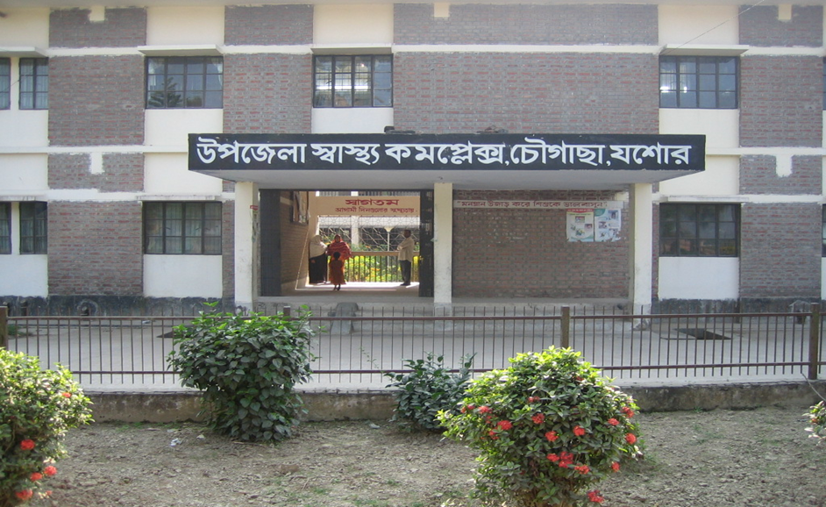
Chowgacha UHC model & Jhenaidah Sadar Hospital Development by local initiatives
Dr. Md.Emdadul Haque
Senior Consultant (Obst & Gynae)
Sadar Hospital Jhenaidah

Slide 2
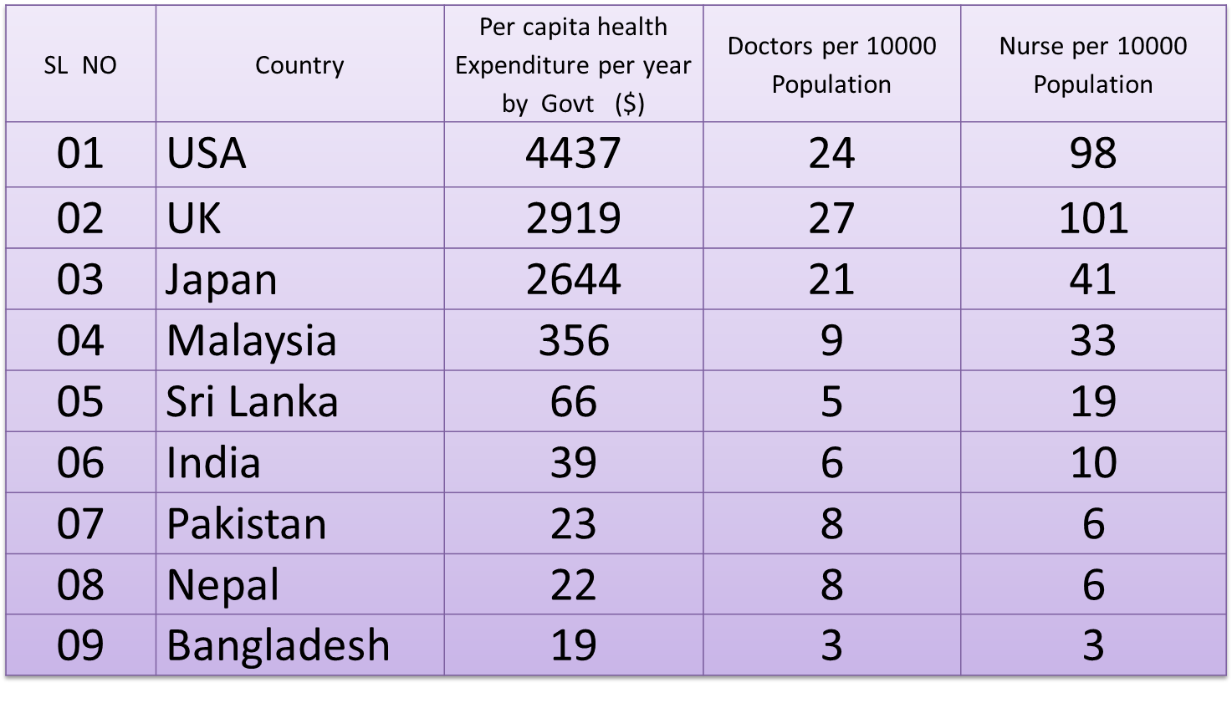
Comparative data of health facilities of different country of the world
From internet 2014

Slide 3

50 BEDED UPAZILA HEALTH COMPLEX
Chowgacha, Jessore.

Slide 4
Achievement of Chowgacha Health Complex
From 1996 to 2012, took initiatives to develop Upazilla level standard services in Chowgacha health complex.
In 2010, Chowgacha Health Complex declared as the model upazilla health complex.

  Mobilized 46 additional workers from community (26 volunteer, 12 cleaners and others 8).
  EOC Beds increased from 11 to 41
  Chowgacha UHC became the best EOC center with 98.4% delivery rate
  Chowgacha UHC achieved MDG target in 2009.
  Chowgacha Health complex is awarded for best performance in EOC form 2005 to 2014.

Slide 5
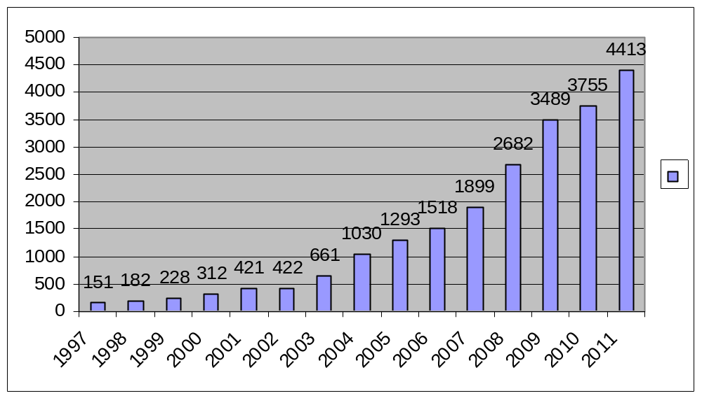
Upazila Health Complex
CHOWGACHA , JESSORE.
EOC Activities : 1997- 2011 (Hospital Delivery )

Slide 6
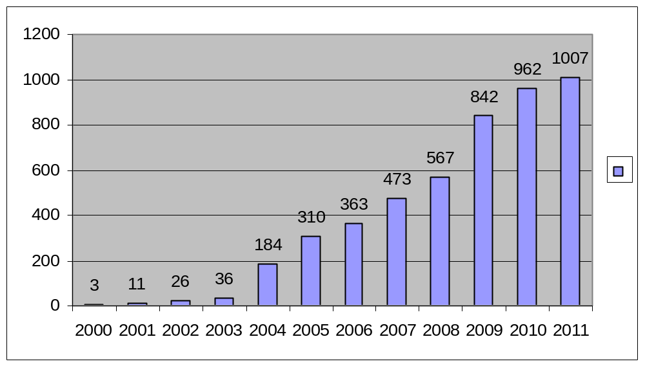
Upazila Health Complex
CHOWGACHA , JESSORE.
EOC Activities : 2000 - 2011 (Caesarian Section)

Slide 7
Upazila Health Complex
CHOWGACHA , JESSORE.
Comparative Data of Delivery of best performing EOC center of Khulna Division in 2011
SL No | Name of institute | NVD | Vacuum Del. | V. Breech | C. Section | Total
01. | Chowgacha UHC | 3346 | 34 | 26 | 1007 | 4413
02. | Ad-din Hospital Jessore. | 1124 | 0 | 0 | 1864 | 3492
03. | Khulna Medical College Hospital | 1581 | 58 | 18 | 1356 | 3013
04. | 250 bed Hospital, Jessore | 1327 | 2 | 25 | 1498 | 2852
05. | 250 bed Hospital, Kustia | 1728 | 0 | 34 | 915 | 2677

Slide 8
Upazilla Health Complex
CHOWGACHA , JESSORE.
COMMUNITY SUPPORTED MANPOWER
TOTAL :46
  Volunteers :26
  Cleaners & guards :16
  Others :04
  The remunerations come from
  Outsourcing :25
  Service provider :21
  The amount of remuneration ranging from 200/= To 8000/=tk. Per month depending upon the style of work, which costs a total of nearly 90,ooo/=Tk per month.

Slide 9
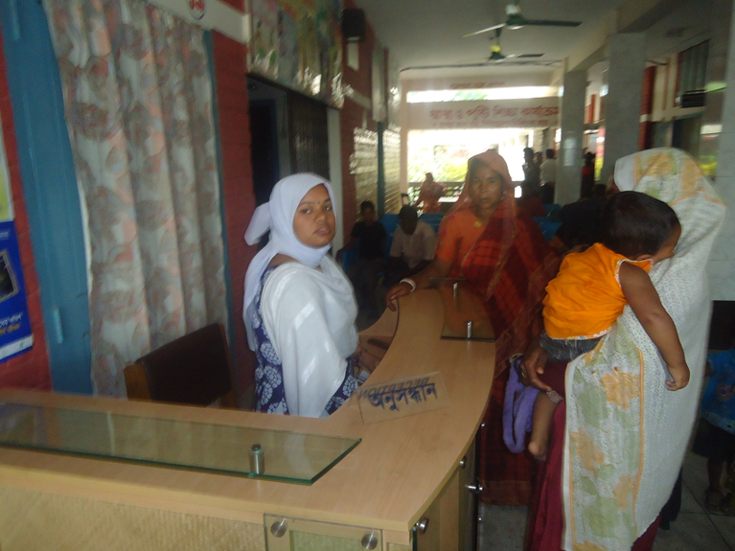
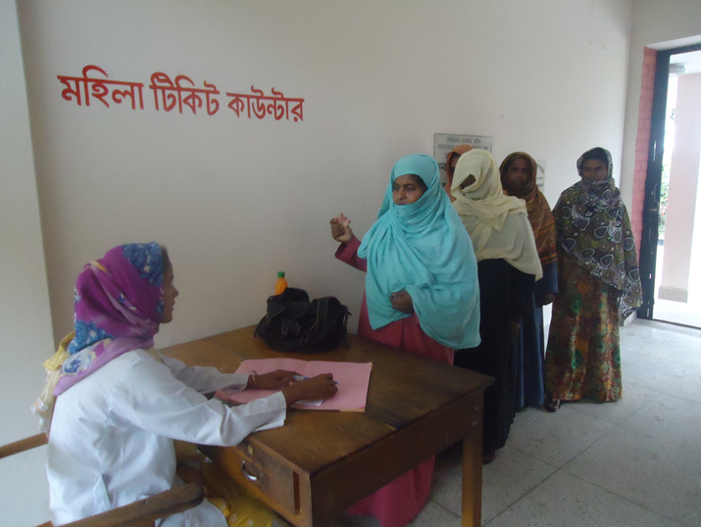
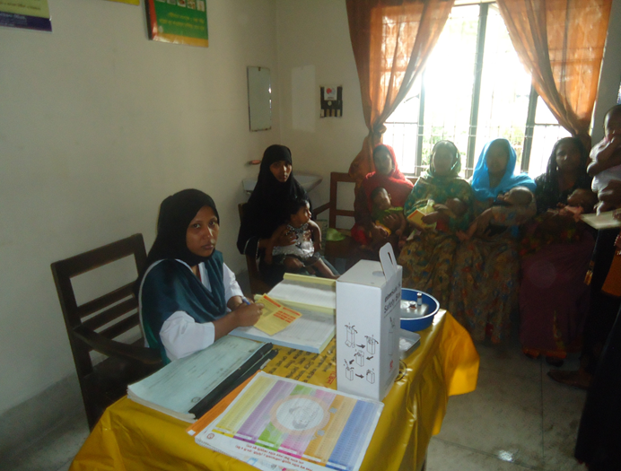
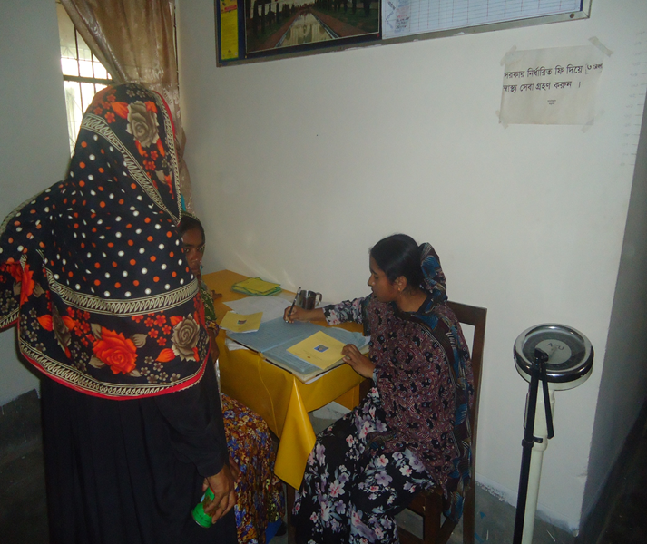

Slide 10
MDG 4 and 5 Achieved at Chowgacha in 2009
Per 1000 live Birth Chowgacha MDG Target National
MMR: .42 1.47 3.2
(MDG 5 Achieved)
IMR: 20.6 31 52
(MDG 4 Achieved)
<5 MR: 22.7 50 65
(MDG 4 Achieved)

Slide 11
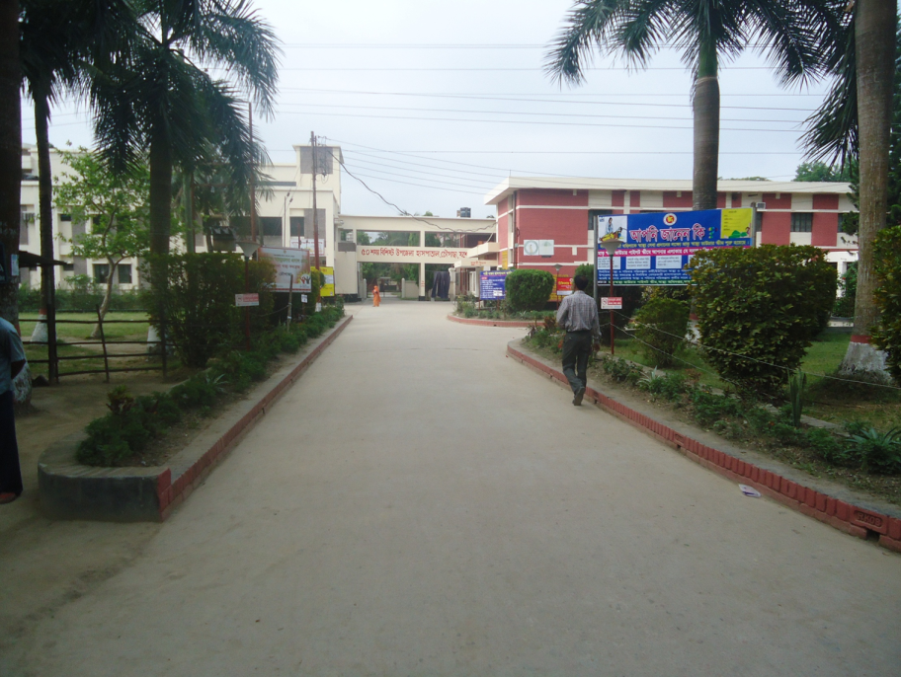
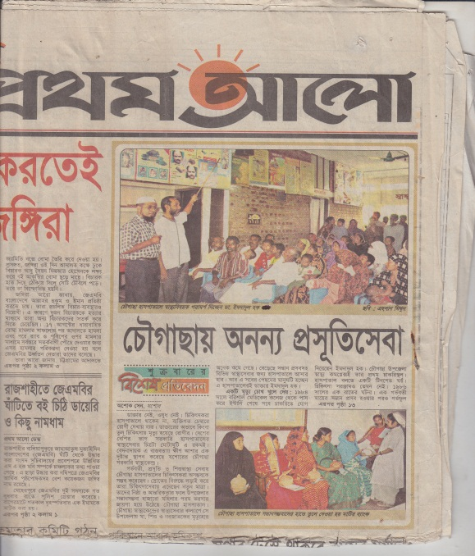
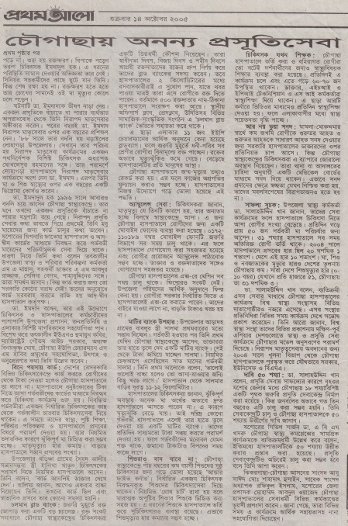
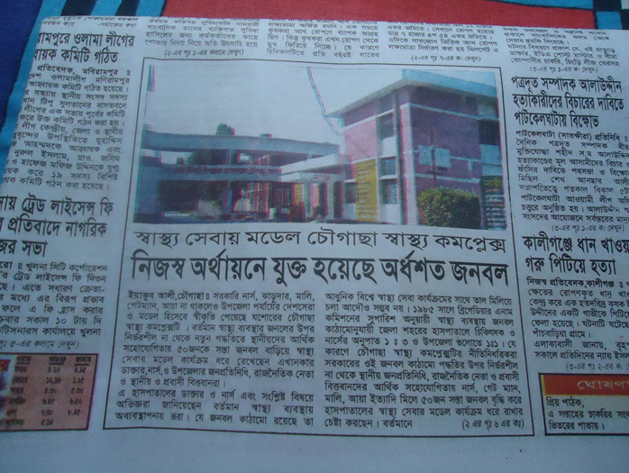
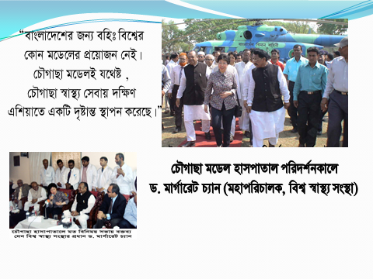

Slide 12


100 kh¨v wewkó m`i nvmcvZvj, wSbvB`n

Slide 13

Sadar Hospital, Jhenaidah
Important post of Human Resources
Serial No. | Person | Post | Vacant
01 | Doctor | 40 | 21
02 | Nurse | 48 | 00
03 | MLSS | 10 | 0
04 | Ward boy | 03 | 03
05 | Ayah | 03 | 03
06 | Cleaner | 07 | 00
07 | Guard | 03 | 00
08 | Gardener | 01 | 00
09 | Electrician | 01 | 00
10 | Trolley man | 00 | 00
11 | Others | --- | ---
 | Total | 151 | 31

Slide 14
Community Support System in Sadar Hospital
53 manpower (Cleaner 20, Ayah & ward boy 21, Guard 6, Volunteer 3, Trolley man 3 ) get TK. 2000 to TK. 3000 per month per person supported by the community.
MP of Jhenaidah-2 donated 14 manpower support.
Doctors of the hospital and Jhenaidah town supports 17 man power.
Mayor of Jhenaidah Paurasava plays an important role in cleanliness, repaired the boundary wall, made 4 dustbins and supports 4 man power and renovation of pediatric word.
Retired secretary donated a generator for 24 hours OT service with a cost of nearly 33 thousand taka.
Chairman of Zahedee foundation supports 10 manpower and an intercom with a cost of nearly two lac taka.

Slide 15

Sadar Hospital, Jhenaidah
Bed Occupancy Rate from 1998 to 2015
Sl. No | Year | Bed Occupancy Rate
01 | 1998 | 126%
02 | 2011 | 146%
03 | 2013 | 165%
04 | 2015 | 193%

Slide 16

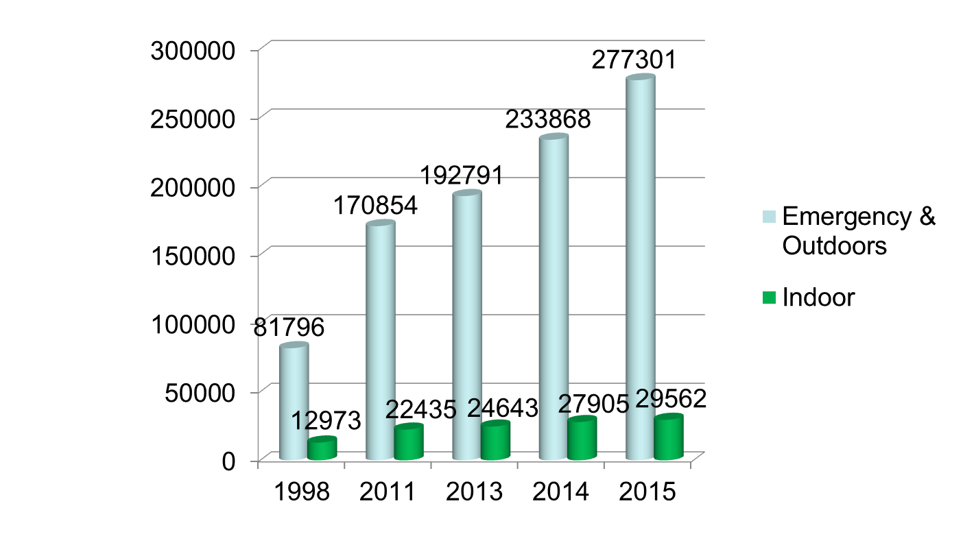
Emergency & Out Door, Indoor Service 1998 to 2015
Sadar Hospital, Jhenaidah

Slide 17

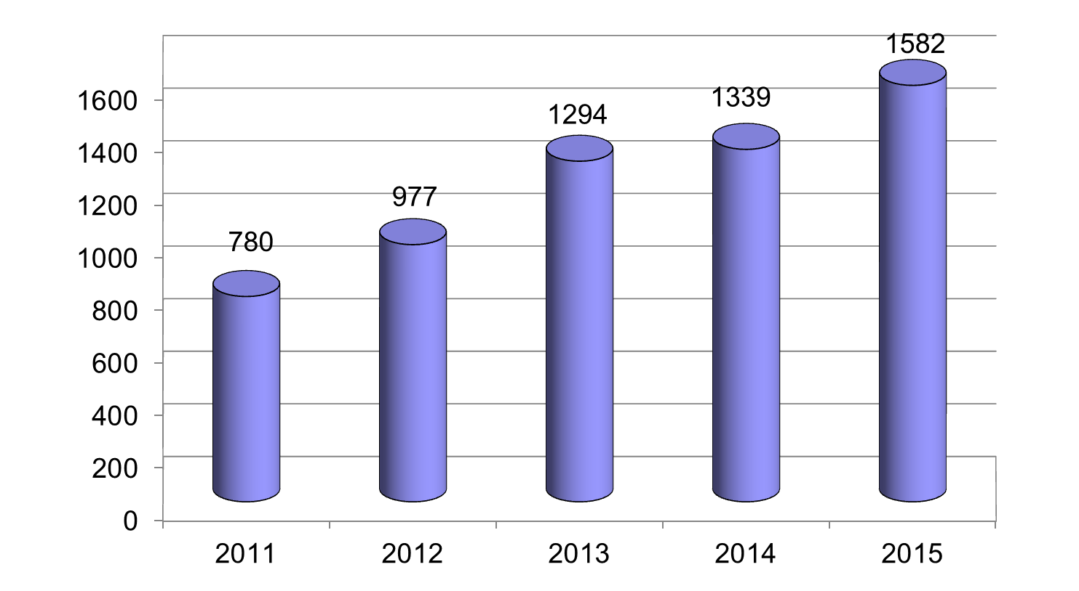
Operation Service (Major) 2011 to 2015
Sadar Hospital, Jhenaidah

Slide 18
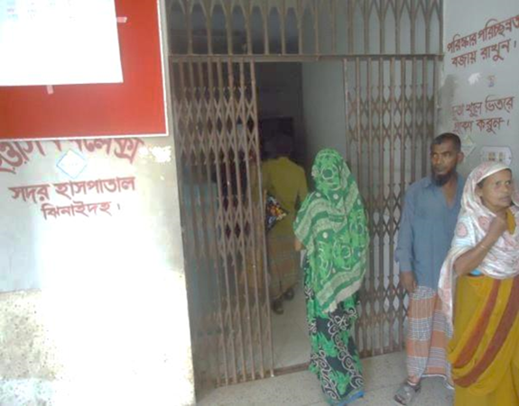
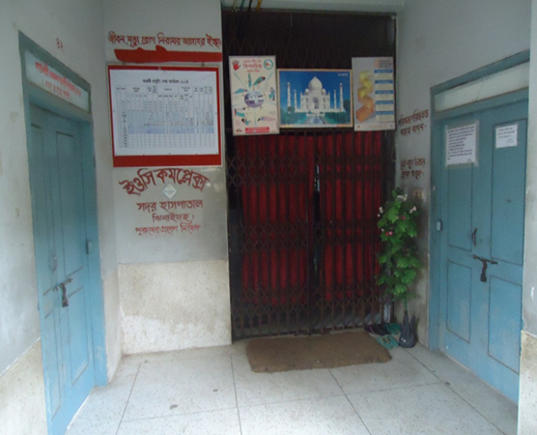
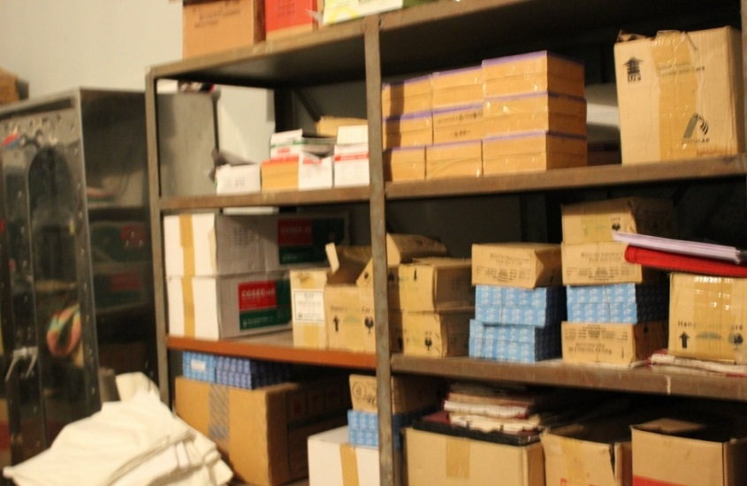
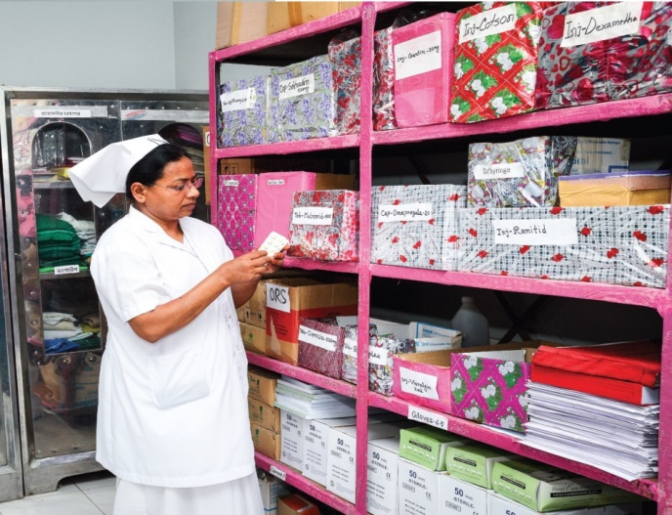
Changes in EOC Ward
Before
After
Before
After

Slide 19


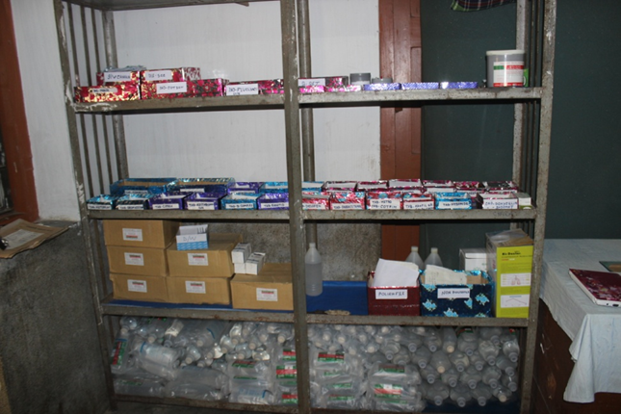
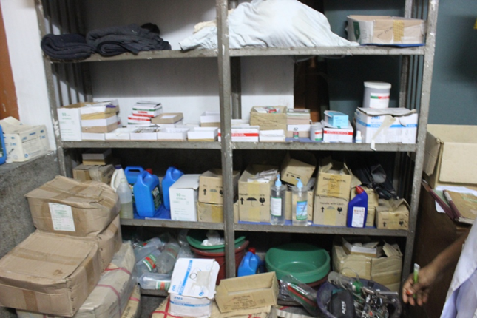

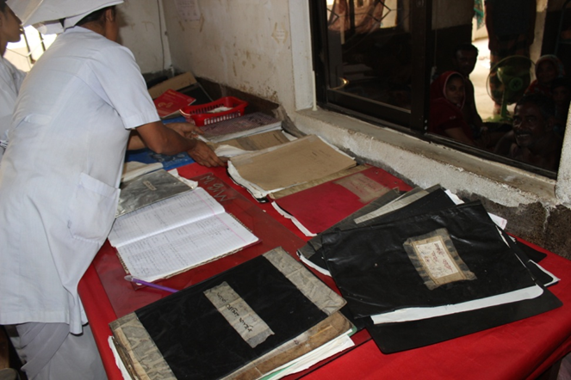
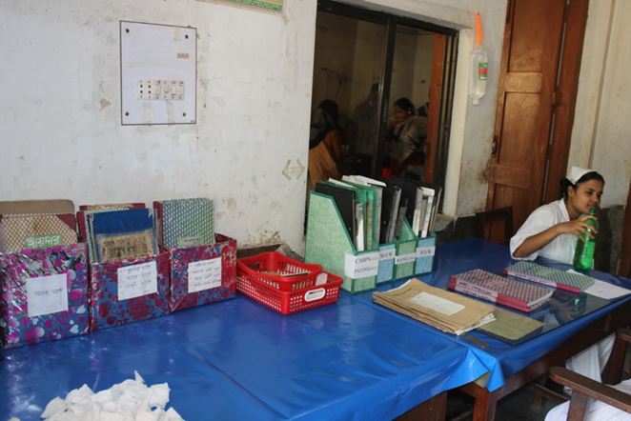

Changes in Surgery Ward

Slide 20
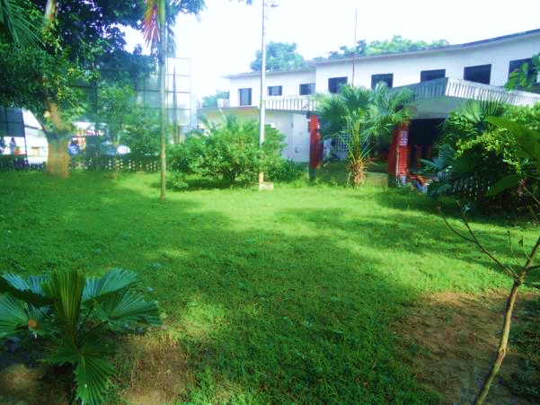
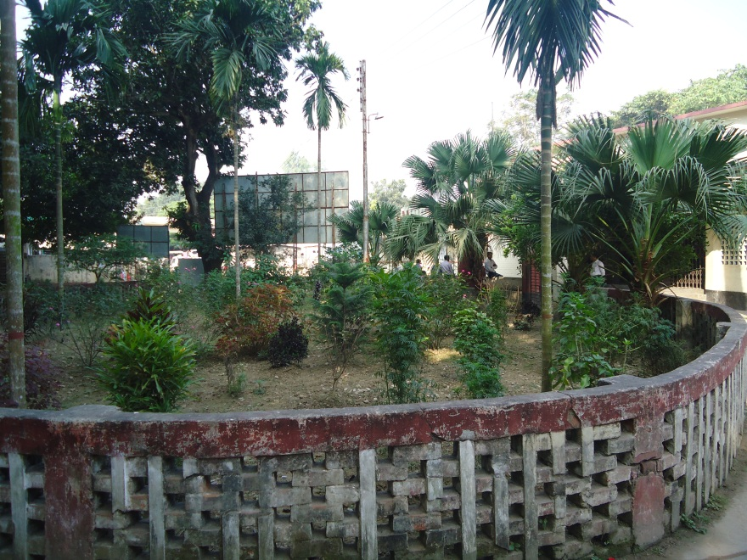
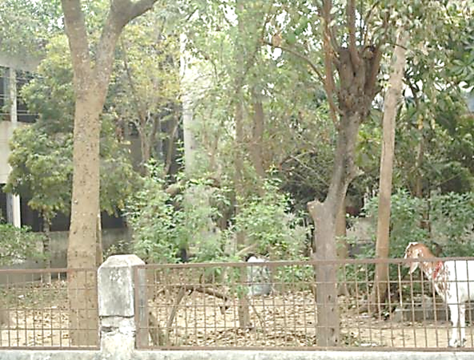
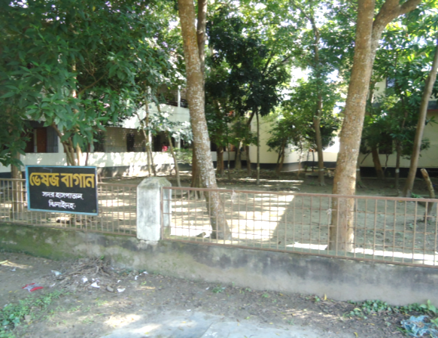
Changes in Gardens of The Hospital
Before
After
Before
After

Slide 21
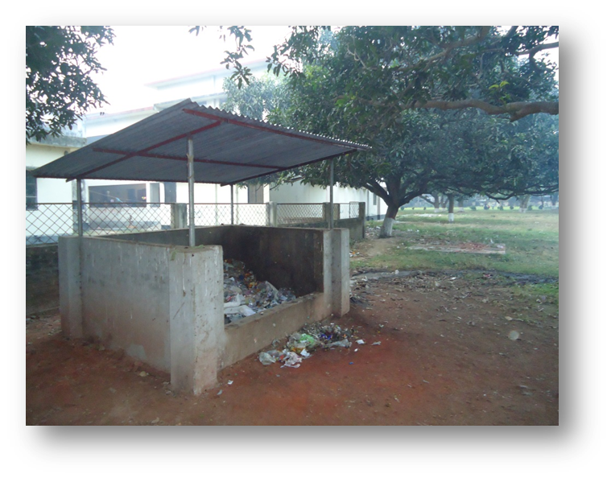
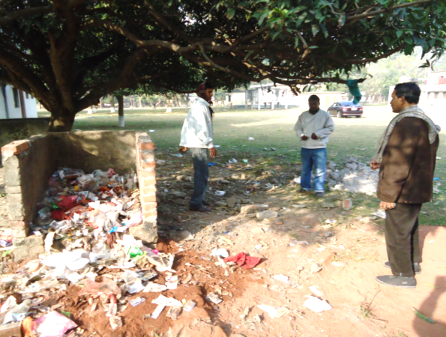
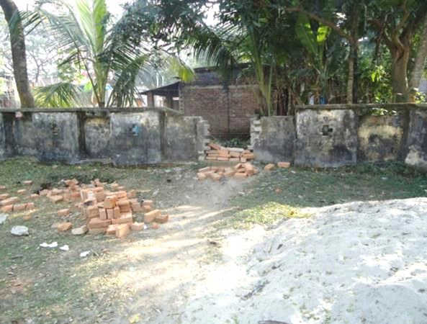
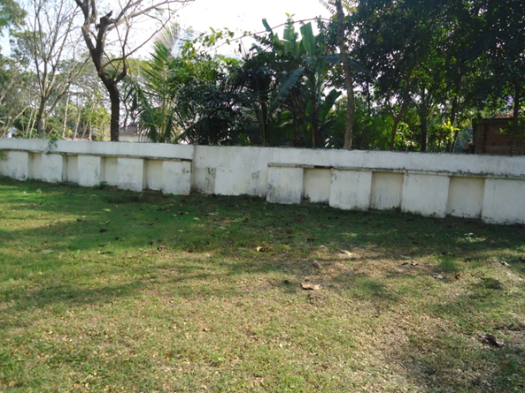
West Management & Campus Protection
Before
After
Before
After

Slide 22
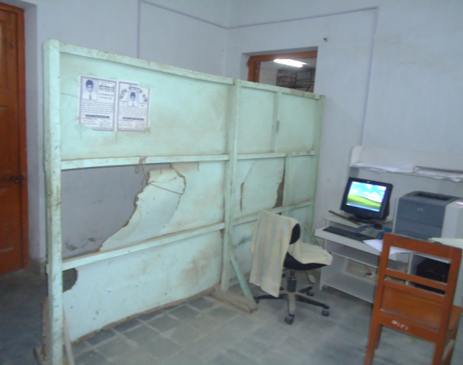
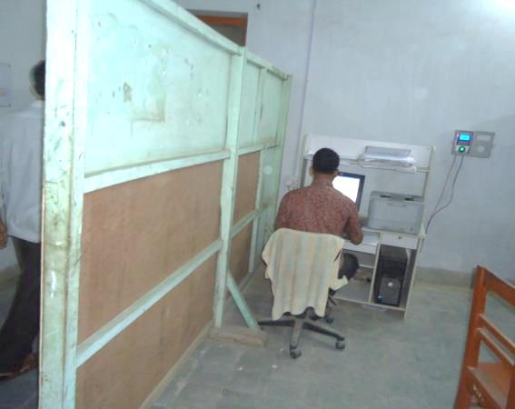
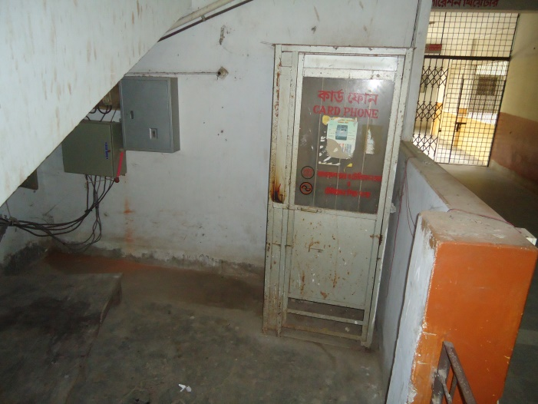
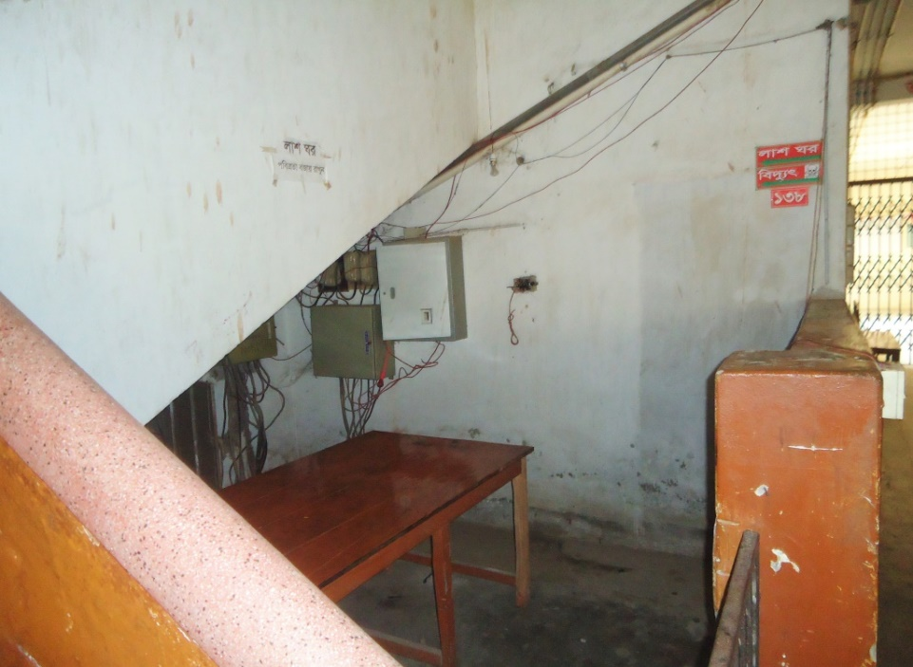
Changes in Office and Hospital Internal Environment
Before
After
Before
After

Slide 23
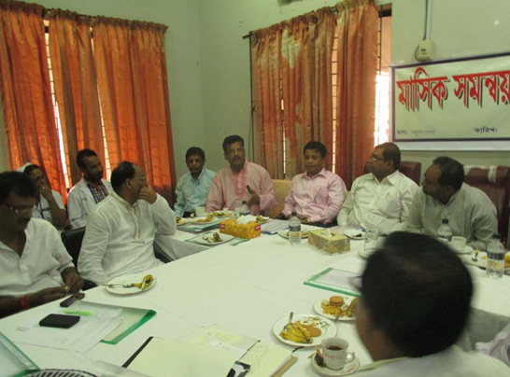
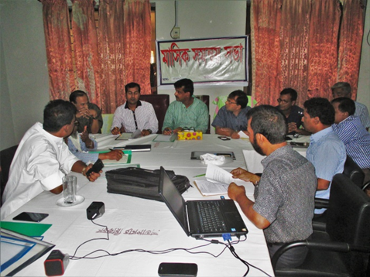
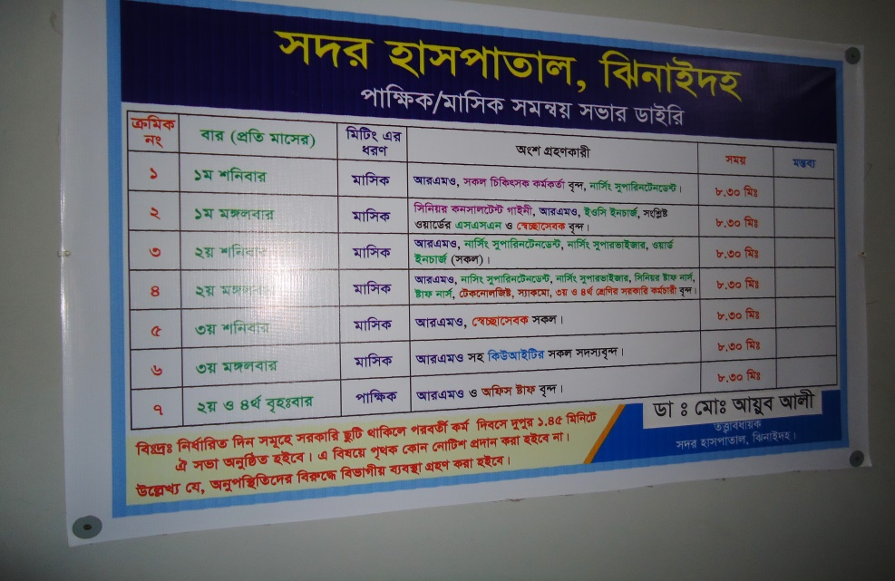
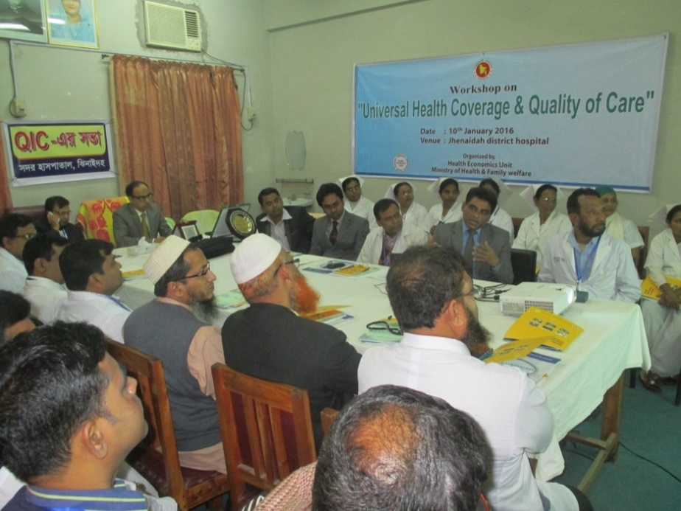
Internal Monitoring System
Meting of health improvement committee
Meting of community support group committee
Monthly meeting schedule
QIC meeting

Slide 24
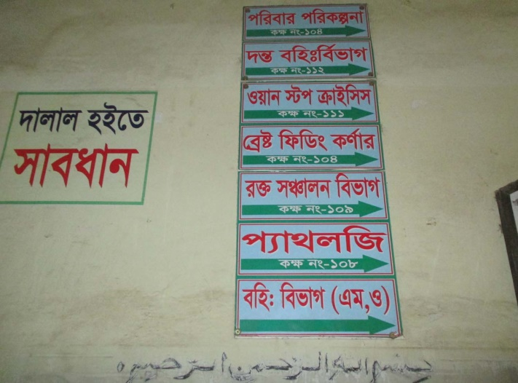
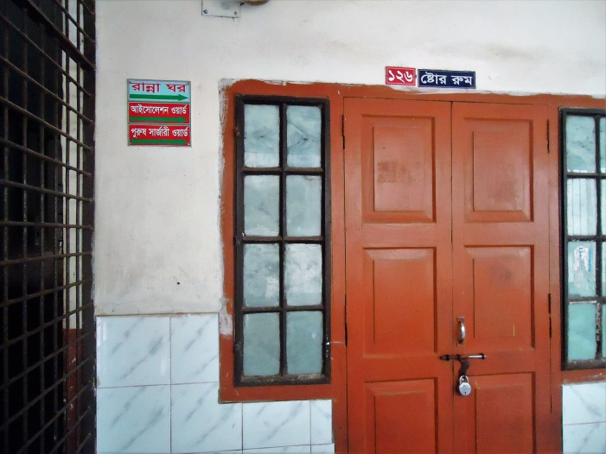
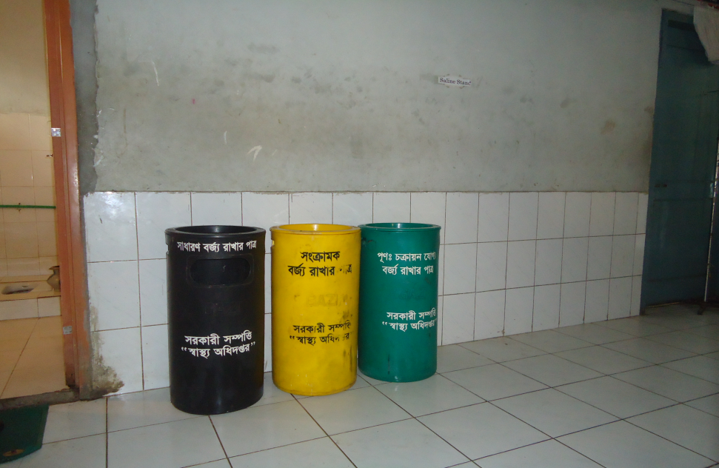
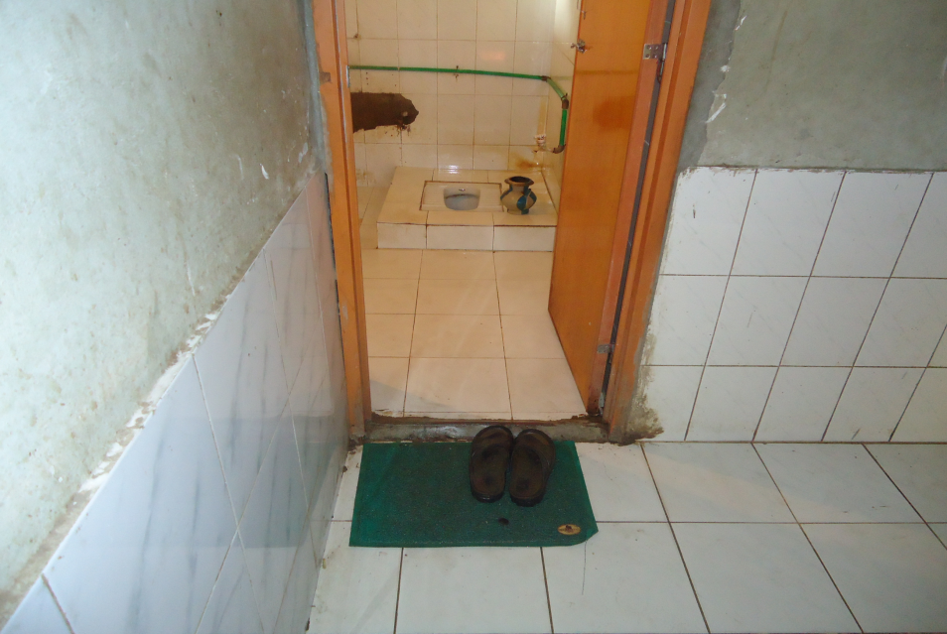
Use of direction sign, labeling of rooms, clean latrine and waist segregation
Use of direction sign
Labeling of rooms
waist segregation
Clean latrine

Slide 25
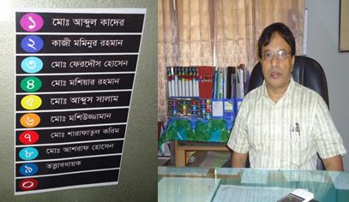
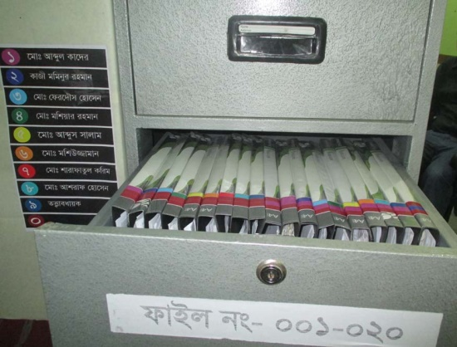
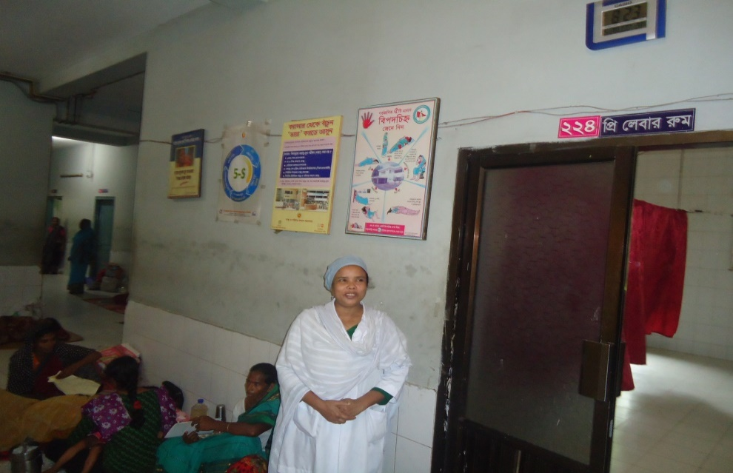
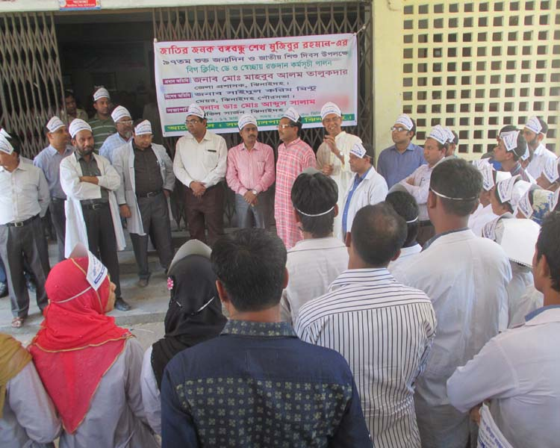
Use of color code, alignment of picture & continuous big cleaning day
Color code
Color code
Alignment of pictures
Big cleaning day
Girls guide for lining of patients

Slide 26
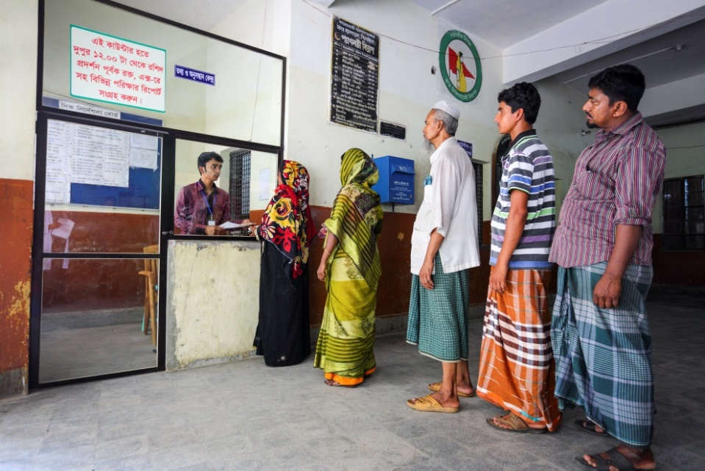
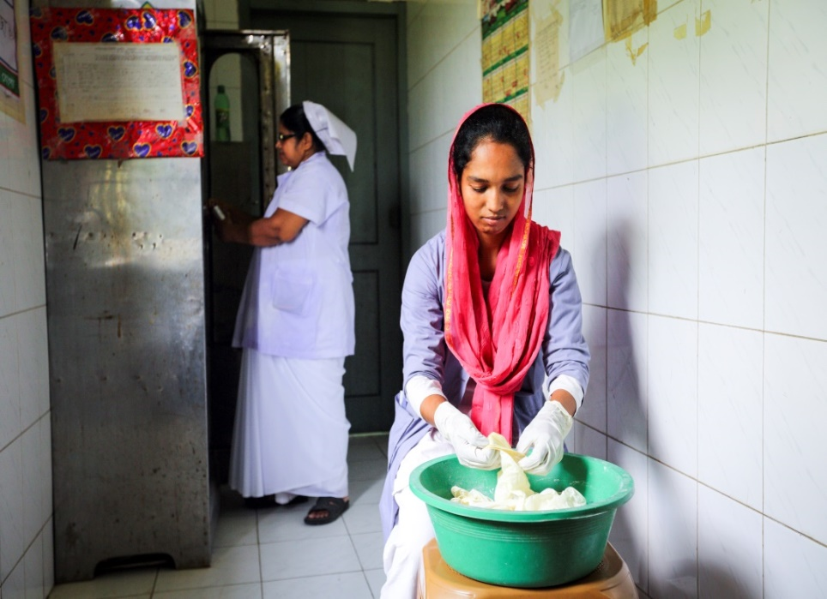


Innovative activities of Jhenaidah Sadar Hospital Page: 1
Reception room
Creation of nursing aid
Health education session
Community engagement

Slide 27




Innovative activities of Jhenaidah Sadar Hospital Page: 2
Starting of 5S KAIZEN-TQM
Neonatal Care Unit
Manobota
Big Cleaning Day

Slide 28



Innovative activities of Jhenaidah Sadar Hospital Page: 3
Community donated intercom
Community Supported Manpower

Slide 29



Improved pediatric word by local initiative

Slide 30




Hospital Environment

Slide 31
Jhenaidah Sadar Hospital, Jhenaidah
Achievement of the Hospital
1. Active Community Participation in health service is an example in Bangldesh.
2. Improved performance of all services specially Pediatric, obstetric, operation and outdoor service.
3. Improved Cleanliness and Beautification of Campus.
4. Functioning of X-Ray service by local initiatives (Social welfare and health partner ship).
5. Improved Security.
6. Improved Financial Management
7. Piloting of “Model District Hospital” is running in Jhenaidah Sadar Hospital.
8. The hospital is awarded 4 times from 2013 to 2016. Stood first award by 5S-KAIZEN-TQM among the 100 bedded district hospitals by defeating Norsingdi Sadar Hospital.

Slide 32


